Slide 1
Midterm Presentation
James Crim

Slide 2
Project Outline
Dataset: CIFAR100, 50,000 images evenly distributed across 100 categories
How to choose the optimal batch size, considering both model performance and cost of computing time
Batch sizes of 8, 32, 64, 256, and 2048 will be run and compared for accuracy, loss (categorical cross-entropy), and computing time

Slide 3
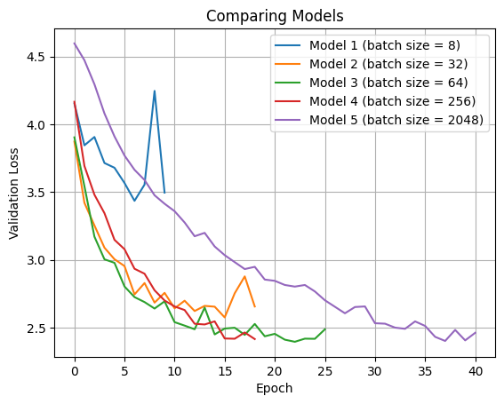
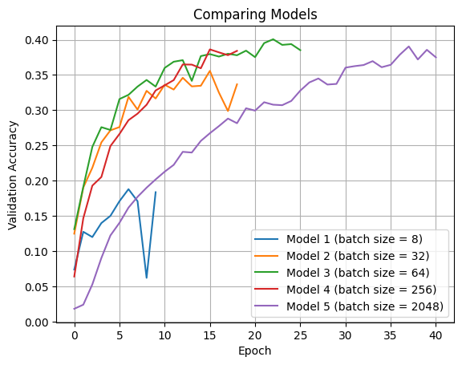
Accuracy and Loss

Slide 4
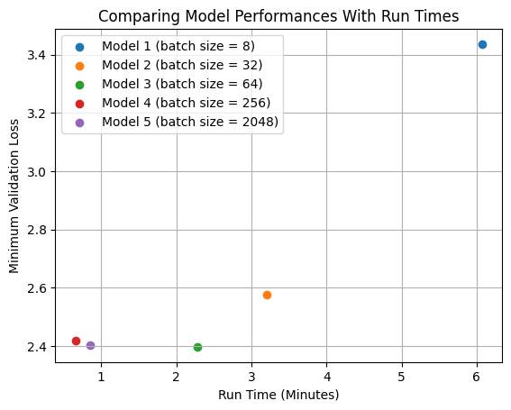
Loss and Run Time

Slide 5
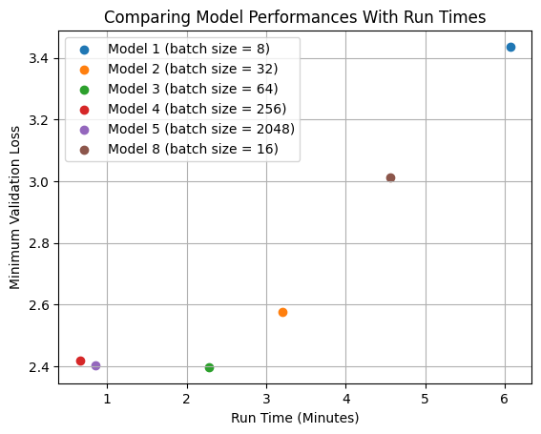
Loss and Run Time UPDATED
← Model 6 (batch size of 1)
Model 7 (batch size of 4) failed to get validated accuracy above chance

Slide 6
Code:
https://github.com/jcrim-gw/Deep-Statistical-Learning/blob/main/Midterm_Crim_James.ipynb

